Slide 1
cloud Databases

Slide 2
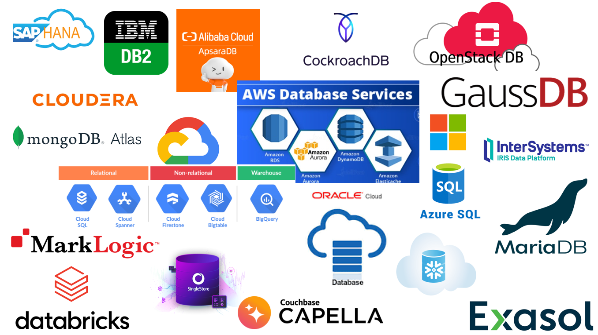

Slide 3

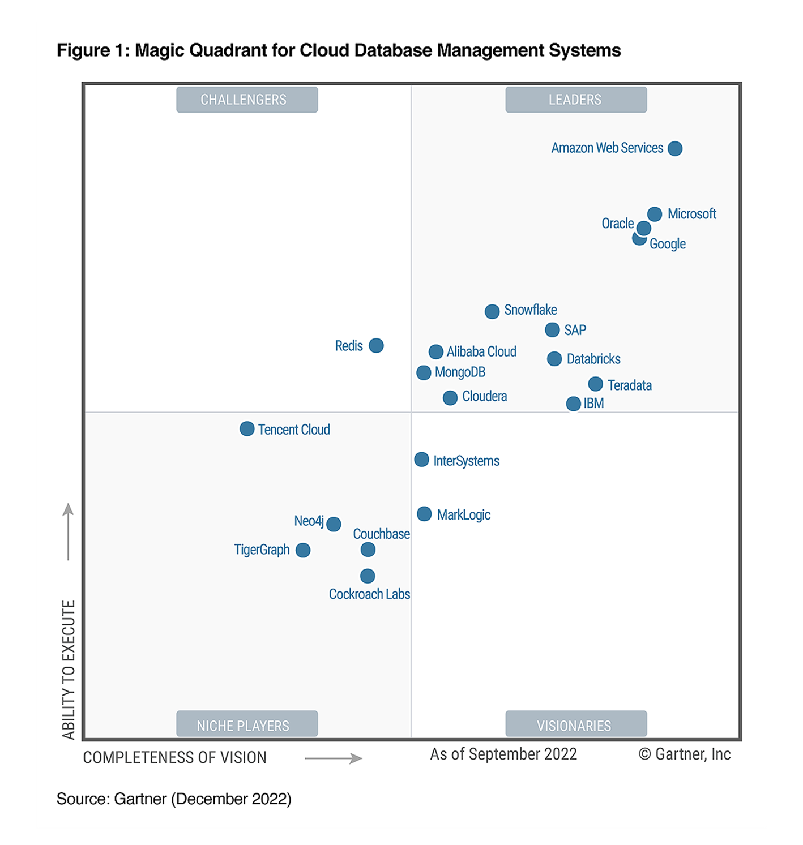
Magic Quadrant by Gartner
A Magic Quadrant provides a graphical competitive positioning of four types of technology providers, in markets where growth is high and provider differentiation is distinct:
Leaders execute well against their current vision and are well positioned for tomorrow.
Visionaries understand where the market is going or have a vision for changing market rules, but do not yet execute well.
Niche Players focus successfully on a small segment or are unfocused and do not out-innovate or outperform others.
Challengers execute well today or may dominate a large segment, but do not demonstrate an understanding of market direction.

Slide 4
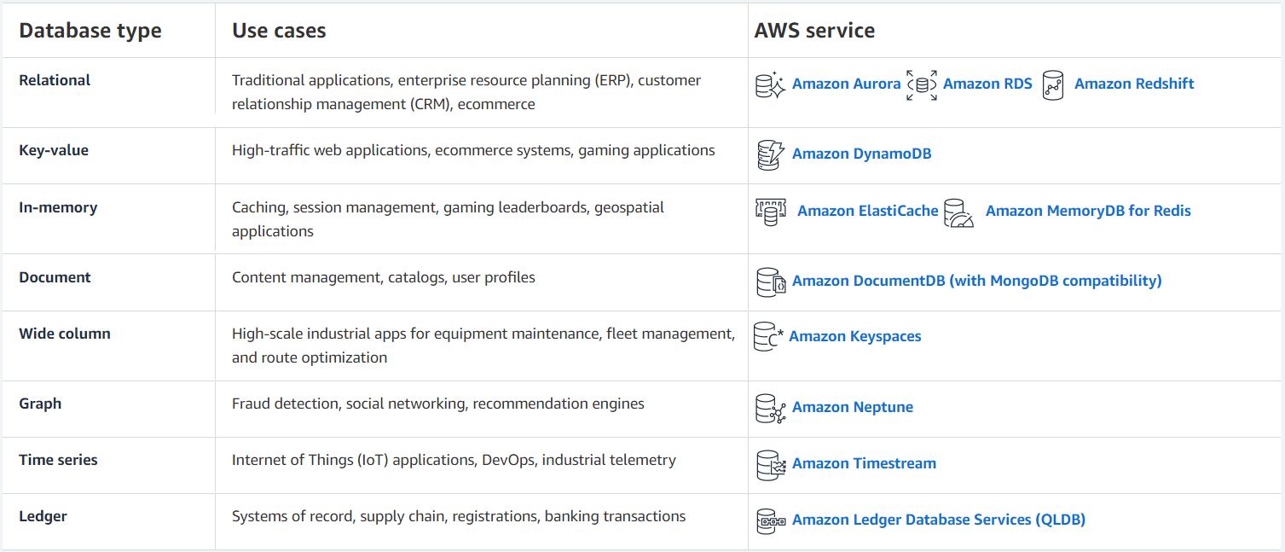
Amazon Web Services
Amazon Web Services is known for its wide range of cloud database management services. It offers cloud database solutions by use cases – making it easier for businesses to select a particular use case and then choose the best-fit cloud database.
From databases to managed traditional applications like ERP (Enterprise Resource Planning) to high-traffic gaming applications, AWS offers cloud databases for all major use cases.
Link: https://aws.amazon.com/products/databases/?nc2=h_ql_prod_db

Slide 5
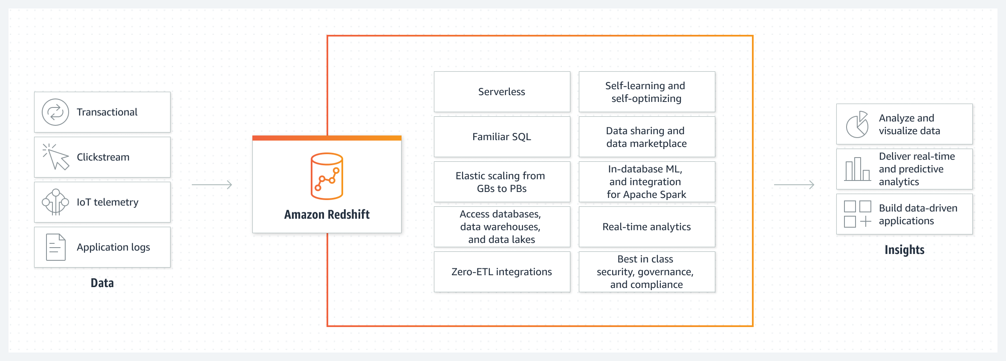
AMAZON REDSHIFT
Amazon Redshift is a data warehouse product which forms part of the AWS cloud-computing platform. It uses SQL to analyze structured and semi-structured data across data warehouses, operational databases, and data lakes, using AWS-designed hardware and machine learning to deliver the best price performance at any scale.

Slide 6
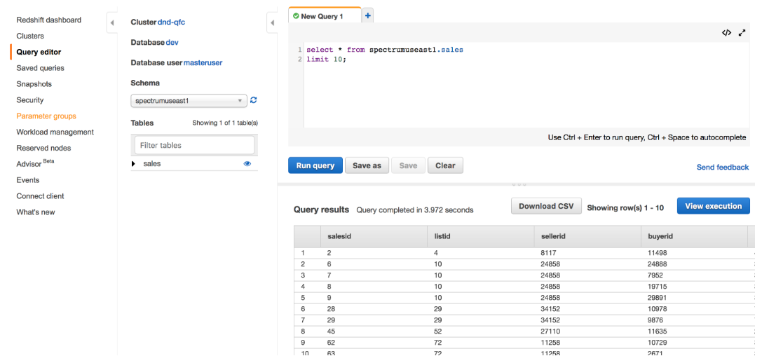
AMAZON REDSHIFT
You can now query data in your Amazon Redshift cluster directly from your AWS Management console, using the new Query Editor.

Slide 7
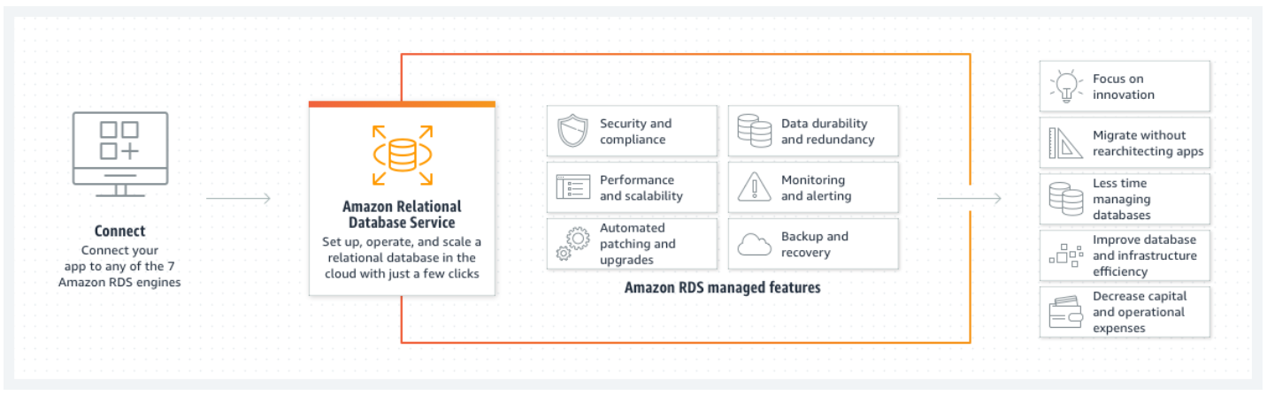
AMAZON RDS
Amazon Relational Database Service (Amazon RDS) is a web service that makes it easier to set up, operate, and scale a relational database in the AWS Cloud. It provides cost-efficient, resizable capacity for an industry-standard relational database and manages common database administration tasks.

Slide 8
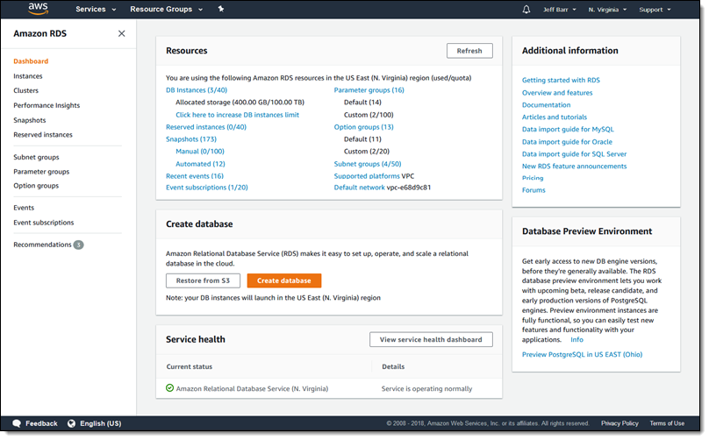
AMAZON RDS CONSOLE
To create an AWS account click here.There are multiple offers of Free Tier depending on your needs: short-term trials or 12 months trials.

Slide 9
GOOGLE
Google offers powerful and scalable cloud database management solutions built on its Google Cloud Platform.
It provides database migration and management services as well as database modernization services.
Link: https://cloud.google.com/products/databases

Slide 10
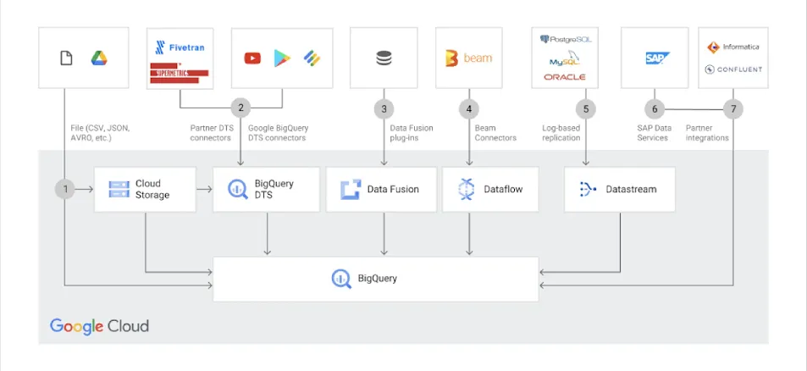
BigQuery
BigQuery is Google's fully managed, serverless data warehouse that enables scalable analysis over petabytes of data. It is a Platform as a Service that supports querying using ANSI SQL. It also has built-in machine learning capabilities. BigQuery was announced in May 2010 and made generally available in November 2011.

Slide 11
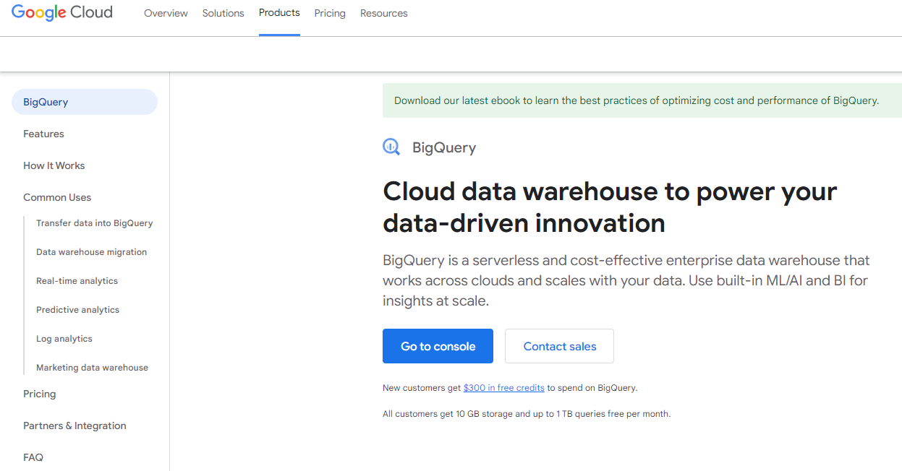
GOOGLE Big Query CONSOLE
The Google Cloud console is the graphical interface that you can use to create and manage Big Query resources and to run SQL queries.

Slide 12
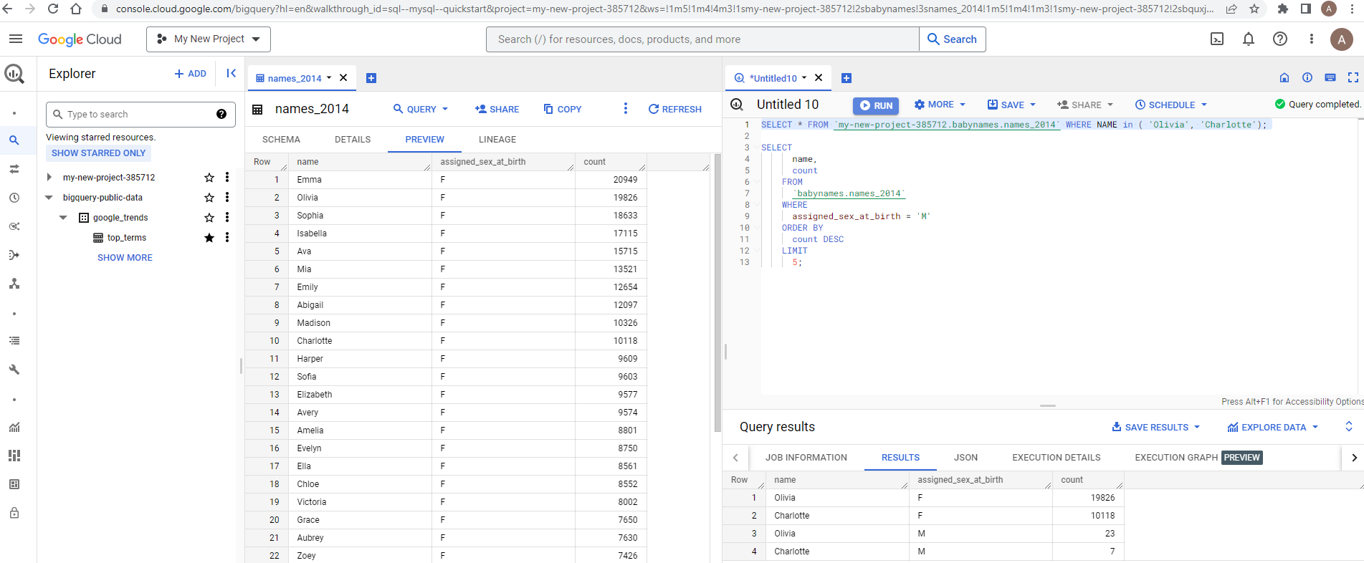
Get started with the Big Query Google Cloud console (Free trial available for 91 days ) →Click here

Slide 13
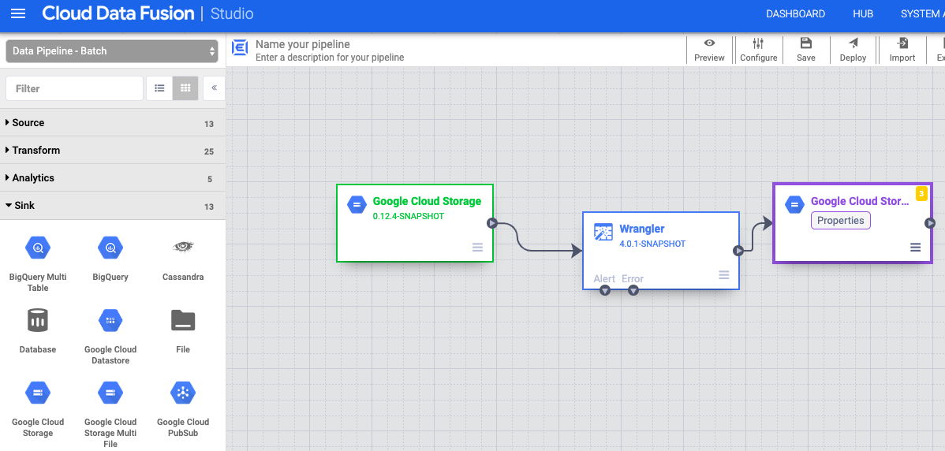
Google Cloud data fusion
Fully managed , cloud native, enterprise data integration service that helps users to efficiently build and manage code-free ETL/ELT data pipelines . The graphical user interface allows users to visually drag and drop elements to create data pipelines which then can be run on a Google Cloud Project

Slide 14
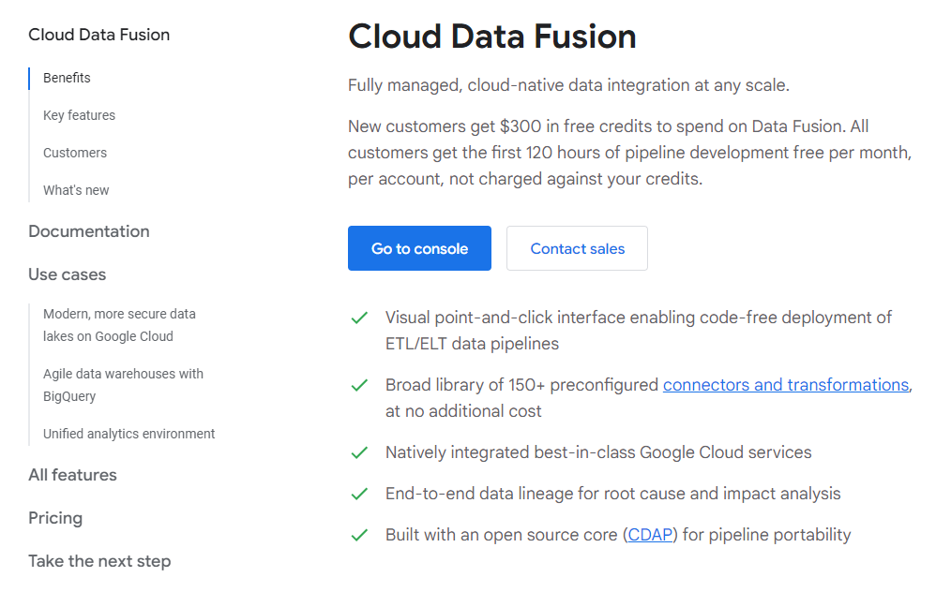
CLOUD DATA FUSION CONSOLE

Slide 15
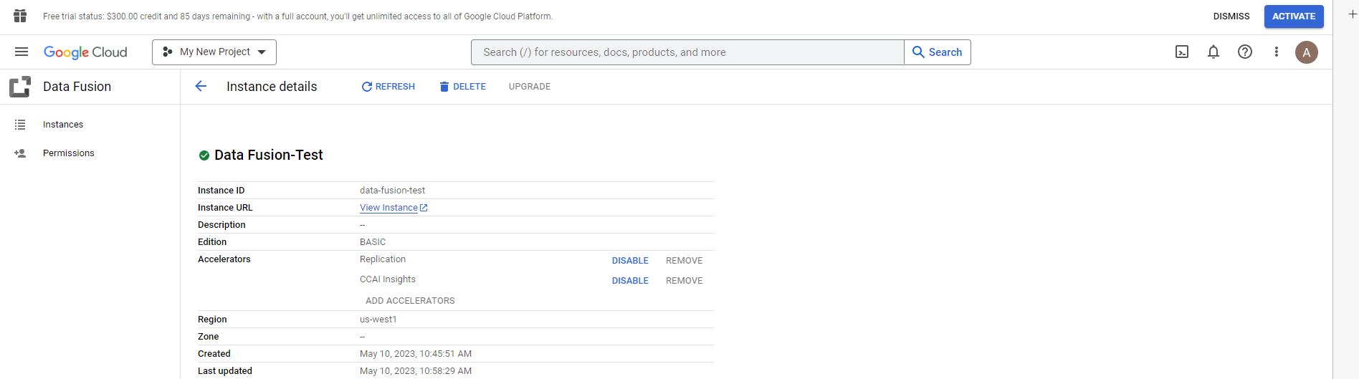
Get started with the Cloud data fusion console (FREE TRIAL AVAILABLE FOR 91 DAYS ) →Click here

Slide 16
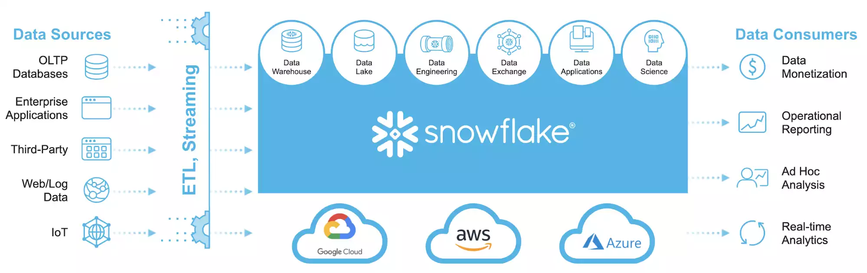
SNOWFLAKE
Developed in 2012 and officially launched in 2014, Snowflake is a cloud-based data platform provided as a SaaS (Software-as-a-Service) solution with a completely new SQL query engine. As opposed to traditional offerings, Snowflake is a tool natively designed for the public cloud, meaning it can’t be run on-premises. The platform provides fast, flexible, and easy-to-use options for data storage, processing, and analysis. Initially built on top of the Amazon Web Services (AWS), Snowflake is also available on Google Cloud and Microsoft Azure. As such, it is considered cloud-agnostic.
Link: https://www.snowflake.com/en/data-cloud/workloads/data-warehouse/

Slide 17
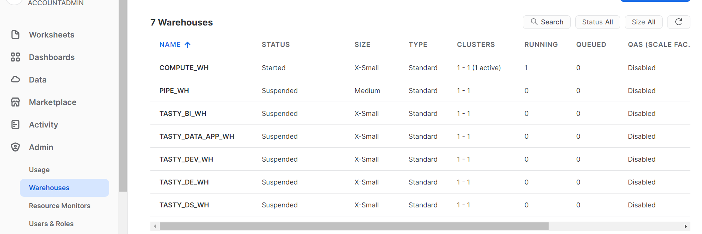
Snowflake - Virtual warehouse

Slide 18

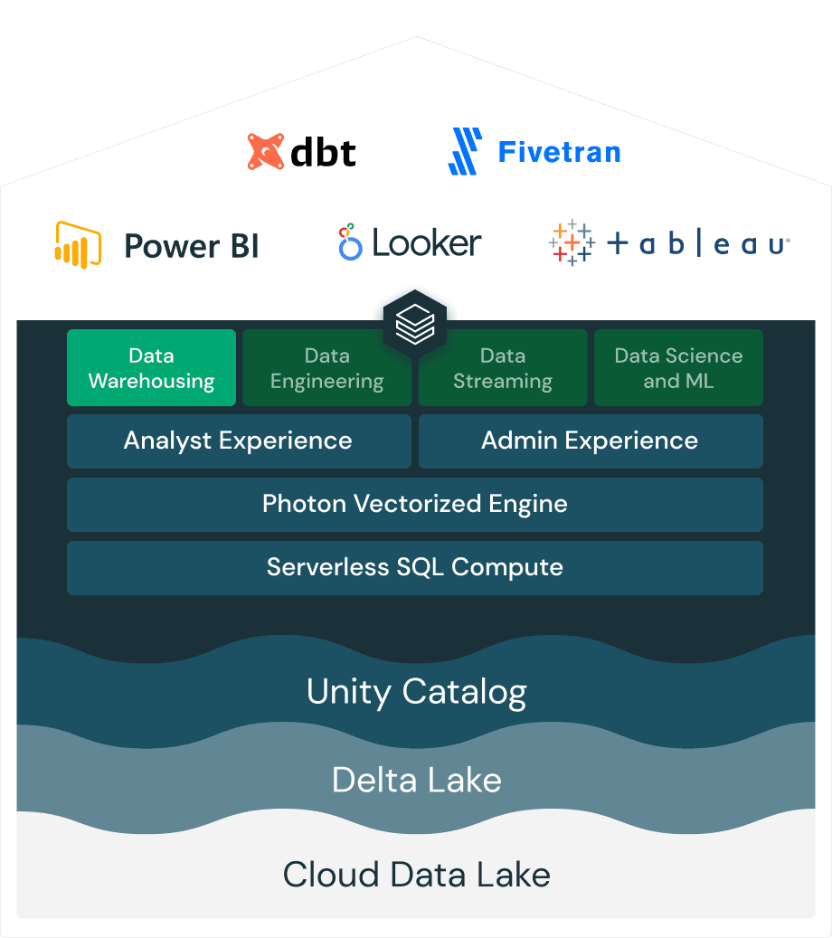
DATABRICKS
Databricks SQL (DB SQL) is a serverless data warehouse on the Databricks Lakehouse Platform that lets you run all your SQL and BI applications at scale with up to 12x better price/performance, a unified governance model, open formats and APIs, and your tools of choice – no lock-in.
Link: Click here

Slide 19
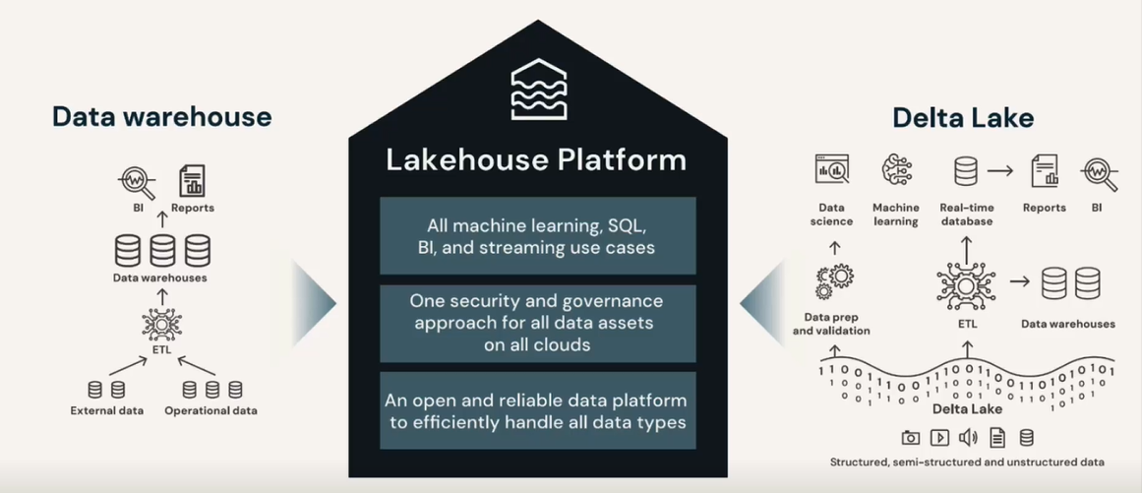
Data Lakehouse

Slide 20
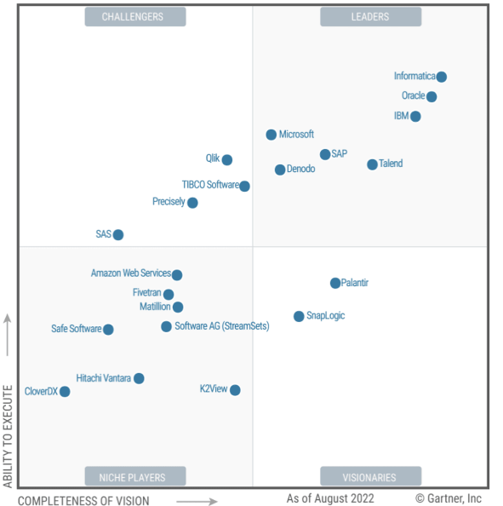
DATA Integration TOOLS
Cloud-based data sources and destinations need modern data integration environments that rely on cloud services.

Slide 21
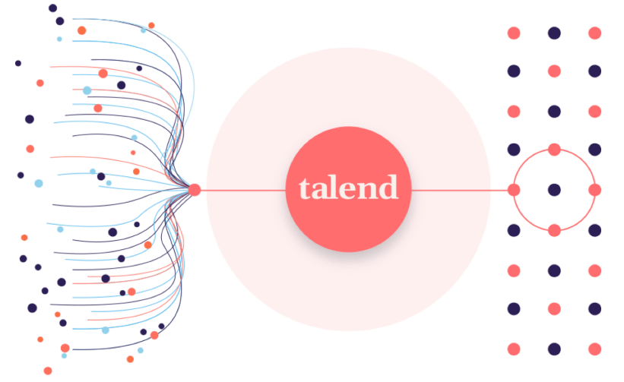
TALEND
Talend provides a unified approach that combines rapid data integration, transformation, and mapping with automated quality checks to ensure trustworthy data every step of the way.

Slide 22
Trainings & certifications

Slide 23
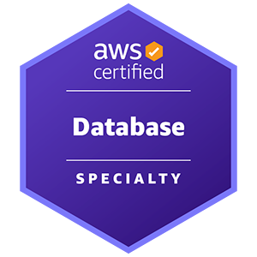
AWS Certified Database - Specialty
Exam overview
Level: Specialty
Length: 180 minutes to complete the exam
Cost: 300 USD
Format: 65 questions; either multiple choice or multiple response.
Delivery method: Pearson VUE testing center or online proctored exam.
Link: Click here
Exam Guide:
Prerequisites: AWS Certified Cloud Practitioner

Slide 24
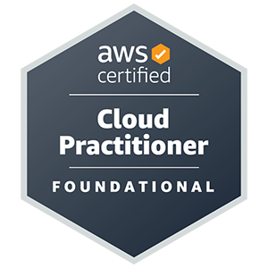
AWS Certified Cloud Practitioner
Exam overview
Level: Foundational
Length: 90 minutes to complete the exam
Cost: 100 USD
Visit Exam pricing for additional cost information.
Format: 65 questions; either multiple choice or multiple response
Delivery method: Pearson VUE testing center or online proctored exam.
Link: Click here
Exam Guide:

Slide 25
INTERNAL TRAININGS
Training | Tuition | Provider | Type | Content level | Duration | Link
AWS Database- Specialty Training (Self-paced) | 120$ | Amazon Web Services | Online | Intermediate | 24 hrs | Click here
AWS Foundations: Getting Started with the AWS Cloud Essentials | Free |  | Online | Beginner | 1 hr | Click here
Amazon Redshift Service Primer |  |  | Online Course | Beginner |  | Click here
AWS Databases Training |  | Accenture Local | Online | Intermediate | 1 hr | Click here
AWS Developer Associate 2022: Database Services |  | Percipio | Online Course |  | 2 hrs | Click here
AWS Associate Solutions Architect 2020: Database Solutions |  |  |  |  | 1 hr | Click here
AWS SysOps Associate 2022: Database Services |  |  |  |  | 1 hr | Click here
Amazon Redshift: A Columnar Database SQL and Architecture |  |  | Online Book |  |  | Click here

Slide 26
A Cloud guru account
In order to receive the access for AWS Database- Specialty Training (Self-paced) training you should have a Cloud Guru account.
In order to create it go to https://go.accenture.com/acgaccess and navigate to “Upskill on AWS”, then follow the steps requested on Register for an ACG Access for AWS page.
An email will be sent to your Training Approver (Dragos Draghici).
As soon as the request will be approved, you will be able to start the training.

Slide 27

Professional Cloud Database Engineer
Exam overview
Level: Specialty
Length: 2 hours
Registration fee: $200 (plus tax where applicable)
Language: English
Exam format: 50-60 multiple choice and multiple select questions
Exam Delivery Method: Take the online-proctored exam from a remote location.
Link: Click here
Exam Guide: Click here
Prerequisites: Associate Cloud Engineer

Slide 28
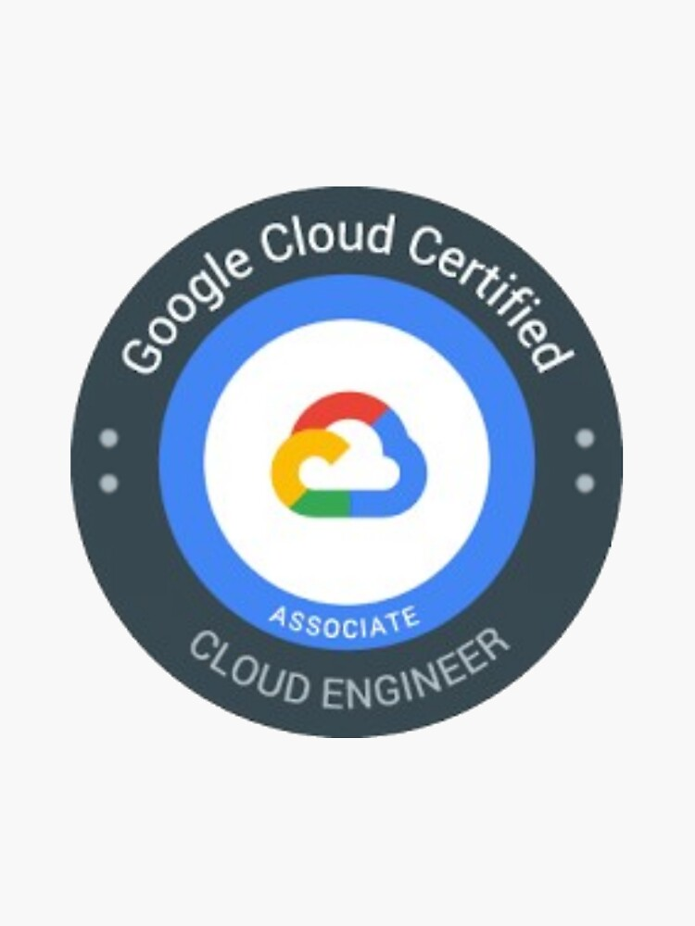
Associate Cloud Engineer
Exam overview
Level: Associate
Length: 2 hours
Registration fee: $125 (plus tax where applicable)
Language: English
Exam format: 50-60 multiple choice and multiple select questions
Exam Delivery Method: Take the online-proctored exam from a remote location.
Link: Click here
Exam Guide: Click here
Prerequisites: None

Slide 29
Bigquery INTERNAL TRAININGS
Training | Tuition | Provider | Type | Content level | Duration | Link
Fundamentals of BigQuery | Free | Percipio | Online Course | Intermediate | 1h 13m 22s | Click here
Implementations with BigQuery for Big Data | Free | Percipio | Online Course | Intermediate | 1h 11m 44s | Click here
Machine Learning with BigQuery ML: Building Regression Models | Free | Percipio | Online Course | Intermediate | 2h 4m 17s | Click here
Big Data Concepts: Getting to Know Big Data | Free | Percipio | Online Course | Beginner | 38m 26s | Click here
Machine Learning with BigQuery ML: Building Unsupervised Models | Free | Percipio | Online Course | Intermediate | 1h 41m 11s | Click here
Google BigQuery Analytics | Free | Percipio | Documentation | - | - | Click here
Modern Data Warehouses (Google-BigQuery-Chapter) | Free | Percipio | Online Course | Intermediate | h 4m 56s | Click here
Working with Google Cloud SQL: Advanced Topics in Cloud SQL (Querying Cloud Sql Data from Google Big Query- Chapter ) | Free | Percipio | Online Course | Intermediate | 1h 59m 29s | Click here
Google Associate Cloud Engineer: Managing Google Cloud Storage (Estimating Query Costs Using Big Query –Chapter ) | Free | Percipio | Online Course | Intermediate | 1h 19m 55s | Click here
Dataproc Operations (BigQuery Features and Capabilities –Chapter ) | Free | Percipio | Online Course | Intermediate | 52m 1s | Click here

Slide 30
Bigquery EXTERNAL TRAININGS
Training | Tuition | Provider | Type | Content level | Duration | Link
Working with BigQuery | Enroll for free | Coursera | Online Course | Beginner-friendly | 1h | Click here
Exploring ​and ​Preparing ​your ​Data with BigQuery | Try for Free: Enroll to start your 7-day full access free trial | Google Cloud via Coursera | Online Course | Beginner Level | Approx. 8 hours to complete (Shareable Certificate) | Click here
Achieving Advanced Insights with BigQuery | Try for Free: Enroll to start your 7-day full access free trial | Google Cloud via Coursera | Online Course | Beginner Level | Approx. 7 hours to complete (Shareable Certificate) | Click here
BigQuery Fundamentals for Oracle Professionals | Free Online Course (Audit) | Google Cloud via Coursera | Online Course | Intermediate | 2 weeks long | Click here
BigQuery Fundamentals for Snowflake Professionals | Free Online Course (Audit) | Google Cloud via Coursera | Online Course | Intermediate | 2 weeks long | Click here
BigQuery Fundamentals for Redshift Professionals | Free Online Course (Audit) | Google Cloud via Coursera | Online Course | Intermediate | 2 weeks long | Click here

Slide 31
Cloud data fusion EXTERNAL & INTERNAL TRAININGS
Training | Tuition | Provider | Type | Content level | Duration | Link
Introduction to Cloud Data Fusion | Free |  | Video | - | 5 min | Click here
Building Batch Data Pipelines on Google Cloud | Try for Free: Enroll to start your 7-day full access free trial | Google Cloud via Coursera | Online Course | Intermediate Level | Approx. 17 hours to complete | Click here
Cloud Data Fusion documentation-Overview | Free | Google Cloud | Documentation | - | - | Click here
Cloud Data Fusion documentation-Videos | Free | Google Cloud | Videos | - | - | Click here
Demo Video - Cognite Data Fusion for Manufacturing | Free | Mediaexchange.accenture | Video | - |  | Click here

Slide 32

SnowPro Advanced: Data Engineer
Exam overview
Level: Specialty
Length: 115 minutes
Registration fee: $375 USD
Language: English
Exam format: 65 Multiple Select and Multiple Choice questions
Exam Delivery Method: Pearson VUE testing center or online proctored exam.
Link: Click here
Exam Guide:
Prerequisites: SnowPro Core Certified

Slide 33
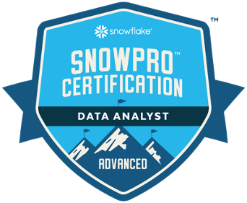
SnowPro Advanced: Data Analyst
Exam overview
Level: Specialty
Length: 115 minutes
Registration fee: $375 USD
Language: English
Exam format: 65 Multiple Select and Multiple Choice questions
Exam Delivery Method: Pearson VUE testing center or online proctored exam.
Link: Click here
Exam Guide:
Prerequisites: SnowPro Core Certified

Slide 34

SNOWPRO CORE CERTIFICATION
Exam overview
Level: Associate
Length: 115 minutes
Registration fee: $175 USD
Language: English
Exam format: 100 Multiple Select and Multiple Choice questions
Exam Delivery Method: Pearson VUE testing center or online proctored exam.
Link: Click here
Exam Guide:
Prerequisites: None

Slide 35
INTERNAL TRAININGS
Training | Tuition | Provider | Type | Content level | Duration | Link
Snowflake Cloud Database - Nordic Cloud First Brown Bag FY23 | Free | Accenture Media Exchange | Video |  | 1 hr | Click here
 |  | Percipio | Online Course | Beginner | 2 hrs | Click here
Getting Started with Snowflake: Using the Snowflake Data Platform
Snowflake for Novice |  | Connected Learning | Learning Boards |  | 7 hrs | Click here
Building Cloud Data Warehouse in Snowflake |  |  |  |  | 18 hrs | Click here
Snowflake for Beginners |  |  |  |  | 17 hrs | Click here
Snowflake for Skilled |  |  |  | Intermediate | 5 hrs | Click here
Snowflake for Advanced |  |  |  | Advanced | 5 hrs | Click here
Snowflake for Expert |  |  |  |  | 4 hrs | Click here
Queries in Snowflake: Search Optimization, External Table Partitions, & Views |  | Percipio | Online Course | Intermediate | 2 hrs | Click here
Data Analytics with Snowflake |  | Percipio |  |  | 21 hrs | Click here
SnowPro Core Certification |  |  |  | Beginner | 20 hrs | Click here
Essentials Hands-on: Data Engineering Workshop |  |  |  |  | 2 hrs | Click here
SnowPro Advanced Data Engineer Certification |  |  |  |  | 30 hrs | Click here
Essentials Hands-on: Data Lake Workshop |  |  |  |  | 2 hrs | Click here
Essentials Hands-on: Data Warehousing Workshop |  | Snowflake |  |  | 2 hrs | Click here

Slide 36
EXTERNAL TRAININGS
Training | Tuition | Provider | Type | Duration | Link
Data Warehousing Workshop | Free | Snowflake | On-Demand Training | 9 hrs | Click here
Data Lake Workshop |  |  |  | 6 hrs | Click here
Data Engineering Workshop |  |  |  | 6 hrs | Click here
Snowflake: Cloud Data Analytics for Dummies |  |  | Digital Book
Snowflake: Cloud Data Engineering for Dummies
Snowflake: Cloud Data Lakes for Dummies
Snowflake: Cloud Data Warehousing for Dummies
All Snowflake Trainings | Free/Paid |  |  |  | Click here

Slide 37
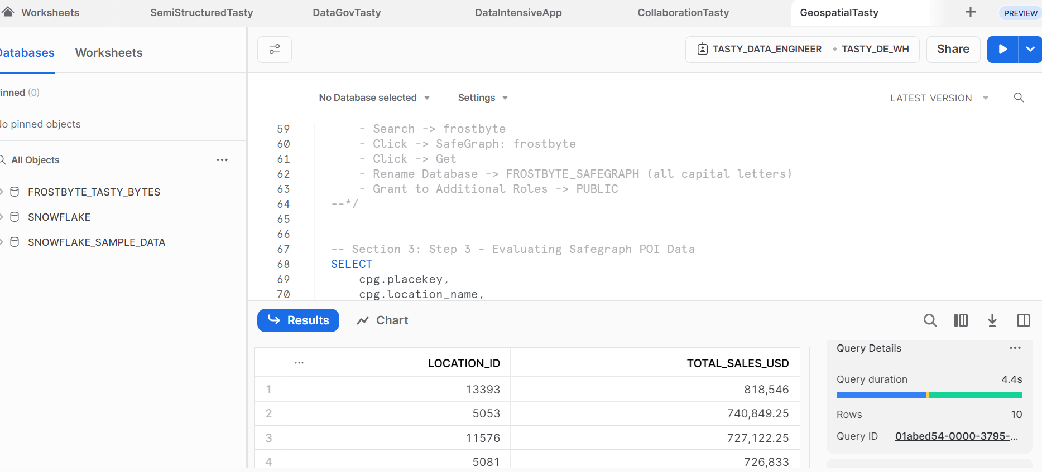
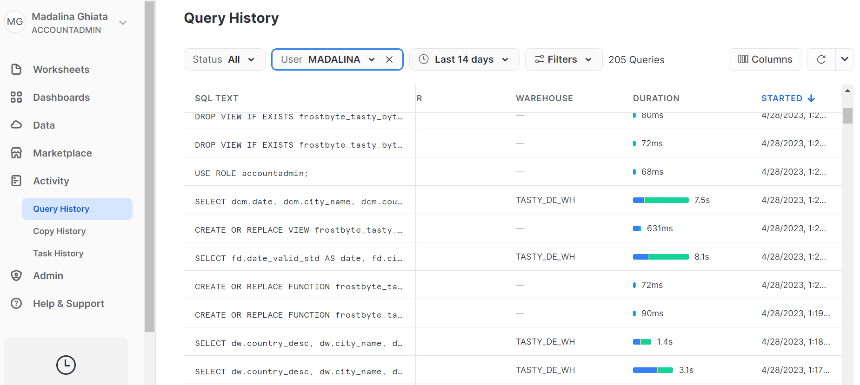
SnowFLAKE free trial
You can register for 30 days free trial: Snowflake Trial
You can register for live workshops: Snowflake Virtual Hands-on Lab | Snowflake Data Cloud
You can try some of the quickstarts tutorials: Snowflake Quickstarts

Slide 38

Databricks Certified Data Engineer Professional
Exam overview
Level: Professional
Length: 120 minutes
Registration fee: $200 USD
Language: English
Exam format: 60 Multiple Choice questions
Exam Delivery Method: Online proctored exam.
Link: Click here
Prerequisites: Databricks Certified Data Engineer Associate

Slide 39

Databricks Certified Data Engineer Associate
Exam overview
Level: Associate
Length: 90 minutes
Registration fee: $200 USD
Language: English
Exam format: 45 Multiple Choice questions
Exam Delivery Method: Online proctored exam.
Link: Click here
Prerequisites: Databricks Lakehouse Fundamentals

Slide 40

Databricks Certified Data ANALYST Associate
Exam overview
Level: Associate
Length: 90 minutes
Registration fee: $200 USD
Language: English
Exam format: 45 Multiple Choice questions
Exam Delivery Method: Online proctored exam.
Link: Click here
Prerequisites: Databricks Lakehouse Fundamentals

Slide 41
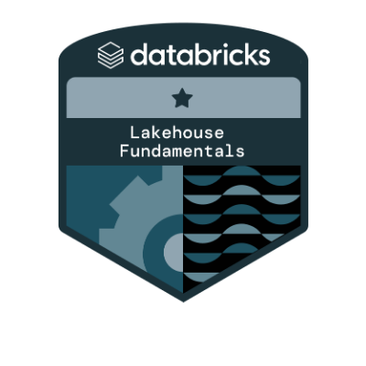
DATABRICKS LAKEHOUSE FUNDAMENTALS ACCREDITATION
Exam overview
Level: Associate
Length: -
Registration fee: Free
Language: English
Exam format: Multiple Choice questions
Exam Delivery Method: Online exam.
Link: Click here
Prerequisites: None

Slide 42
INTERNAL TRAININGS
Training | Tuition | Provider | Type | Content level | Duration | Link
Databricks Certified Data Analyst Associate (Registrations only) | Free | Databricks | Online Course | Intermediate | 10 hrs | Click here
Databricks Associate Data Engineer Certification Track | Free | Connected Learning | Learning Board | Intermediate | 20 hrs | Click here
Databricks Certified Data Engineer Professional Track |  |  |  | Advanced | 15 hrs | Click here
EXTERNAL TRAININGS
Training | Tuition | Provider | Type | Content Level | Duration | Link
Databricks Lakehouse Fundamentals | Free | Databricks | Online Course | Beginner | 3hrs | Click here
Databricks Training Catalog |  |  | Board |  |  | Click here

Slide 43
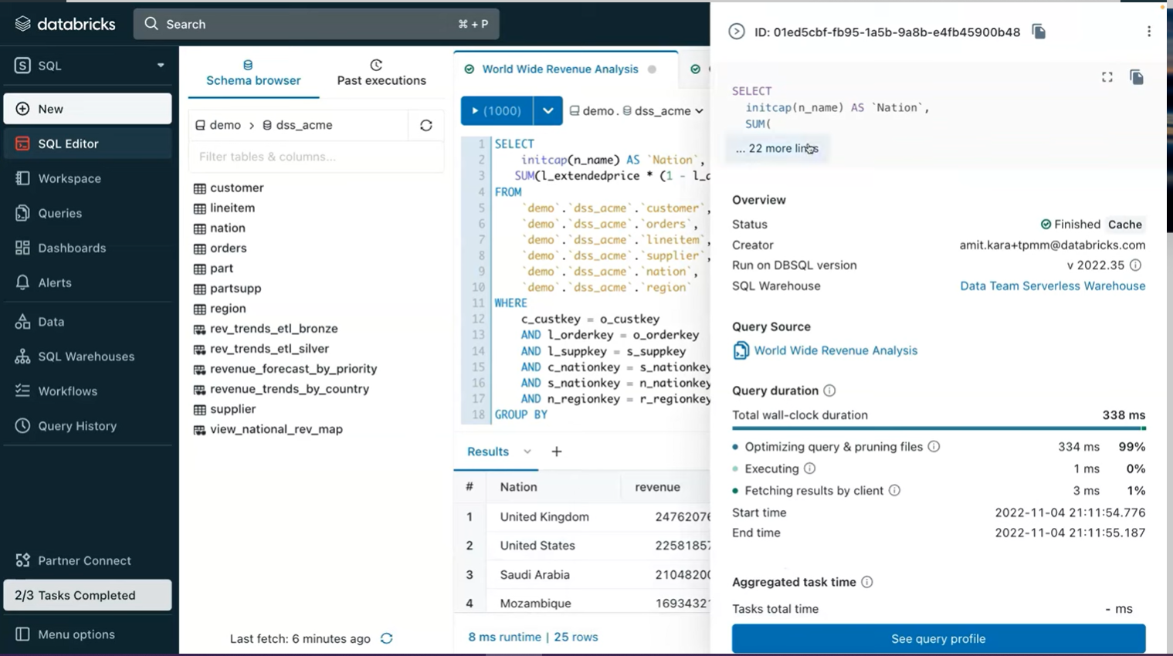
EXTERNAL TRAININGS
Training |  | Tuition | Provider | Type | Duration | Link
Databricks Lakehouse Fundamentals | Free | Databricks | Online Course | Beginner | 3hrs | Click here
Databricks Training Catalog |  |  | Board |  |  | Click here
Documentation here
To sign up for the Databricks Academy free trainings click here

Slide 44
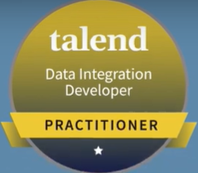
Talend Data Integration Certified Developer Exam
Exam overview
Level: Associate
Length: 90 minutes
Registration fee: 175$
Language: English
Exam format: -
Exam Delivery Method: Online proctored exam.
Link and Exam Guide: Click here
Prerequisites: Talend Data Fabric Explorer

Slide 45
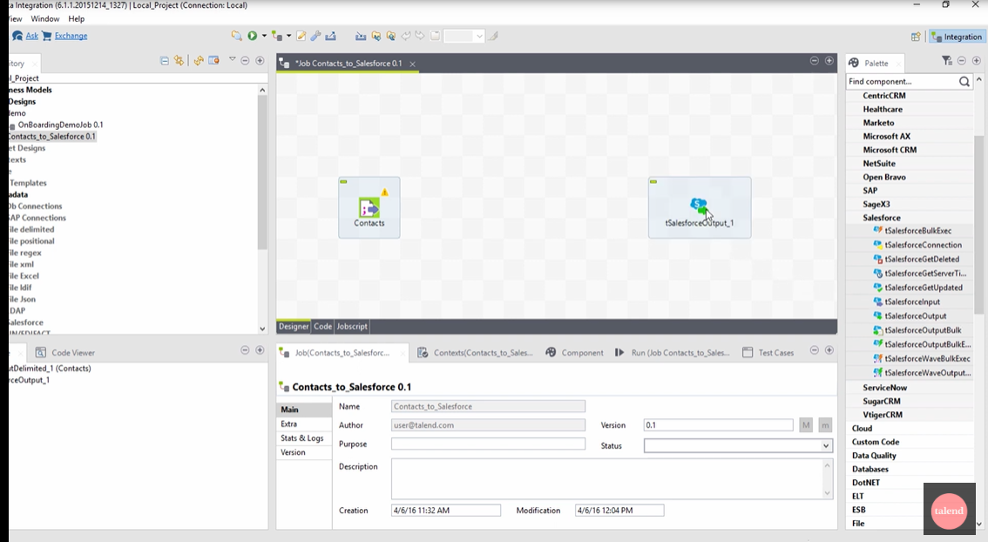
TRAININGS
Training | Tuition | Provider | Type | Duration | Link
Talend | Free | Accenture Board | Beginner |  | Click here
Introduction to Data Integration |  | Talend academy | Beginner | 1.8hrs | Click here
Talend Data Integration Free Online Course |  | Big Data ETL |  |  | Click here
Free trial(14 days) available here
Talend Academy sign up for trainings: here

Slide 46
GOOD TO HAVE
Training | Tuition | Provider | Type | Content level | Duration | Link
Python Fundamentals Bootcamp | Free | Percipio | Learning Collection | Beginner | 11hrs | Click here
Python |  |  |  |  | 48hrs | Click here
Python Projects for Beginners: A Ten-Week Bootcamp Approach to Python Programming |  |  | Book |  | 5hrs | Click here
Python Basics |  |  | Online Course |  | 2hrs | Click here
Python for Data Science |  |  | Learning Collection | Intermediate | 17hrs | Click here

Slide 47
Next steps

Slide 48
DEADLINE
AUGUST END OF THE MONTH!

Slide 49
Q&A

